Slide 1
Software Testing
Code-Based, Unit, Path Testing
(Or, Structure-Based, Unit, Control Flow Testing)
Presented By
Ning Chen, Ph.D.
Professor
Department of Computer
Science
California State University,
Fullerton
© Ning Chen, 2017
*

Slide 2
Module Objectives
This module focuses on the Code-Based, Unit, Path Testing
(Or, Structure-Based, Unit, Control Flow Testing).

Slide 3
Bottom-Up Vs. Top-Down
There are two main ways of “regurgitating knowledge.” One is bottom-up and the other is top-down.

Slide 4
Bottom-Up
In a bottom-up approach, the readers are given parts (definitions, theories, proofs …) first, then some conclusions/results later. Nothing wrong is the bottom-up approach, but, quite often, by the time you finished the parts without seeing any big pictures, you are so tired and may lose interest.

Slide 5
Top-Down
We prefer to use the top-down approach in our way of “regurgitating” code-based testing methods to our readers.
The top-down approach starts with motivation, followed by observation, and then some common-sense solution. For sure, the common-sense solution is never rigorous (but, it does offer an intuitive, intimate and holistic understanding of the issue).

Slide 6
Original Research
If the readers want to make sure that the common-sense solution stands in all situations, they may want to dig out the original (first hand) research results instead of the regurgitated second-hand information offered by a textbook.

Slide 7
Abstraction
The top-down approach starts with abstraction. Imaging that you are a user of google maps, you want to use the zoom in-and-out feature. Seeing things at the street level is good, but, from time to time, you really want to see things from high above.

Slide 8
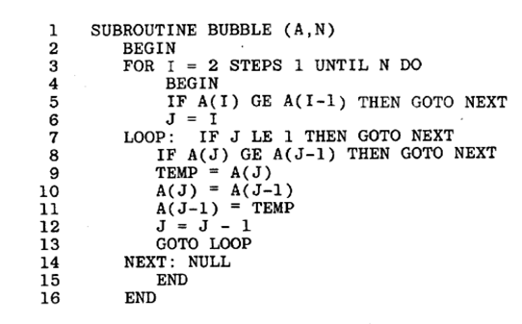
Code (Abstraction)
When we look at a given source code, we also want to have the zoom in-and-out capability (it is called abstraction).

Slide 9
Observation
We start our observation with an example from an old① research result [Paige, 1977].
①You can tell it is old – goto statements are used all over the place.

Slide 10
Observation
If we consider each program statement as a node, we may end up with the following “Program Graph.”

Slide 11
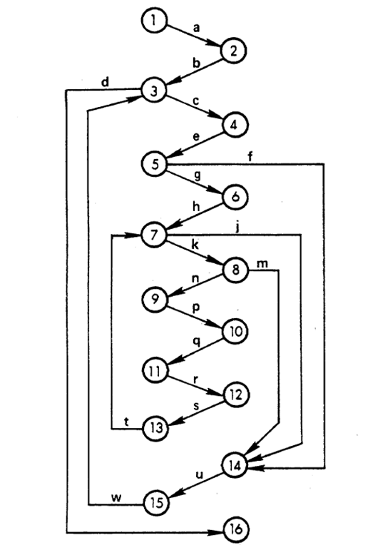
Program Graph

Slide 12
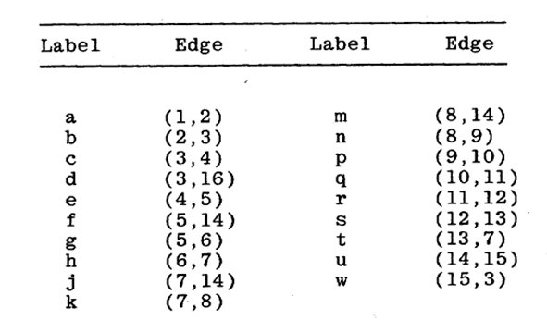
Program Graph

Slide 13
Idea
How do we reduce the complexity of the given program graph? One intuitive idea is [Paige, 1977]:

Slide 14
Idea
A segment is a block of consecutively executable statements/nodes with one entry and one exit; any statement within a particular segment is executed if and only if all statements within that segment are executed and each statement is found in one and only one segment.

Slide 15
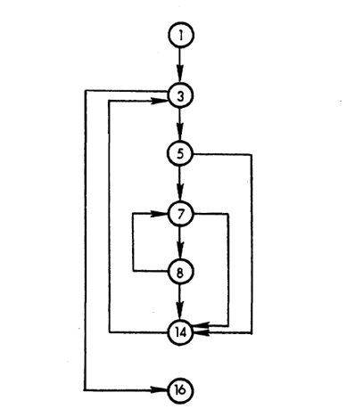
Segment Graph
If we apply the above idea to our program graph, we end up with a “segment graph” as shown below:

